Slide 1
S3fs in the wide area
Alvaro Llanos

Slide 2
Motivation
Reduce delay of the wide-are-network
Better end-user experience
Improve bandwidth use ? (deciding when to flush the cash)

Slide 3
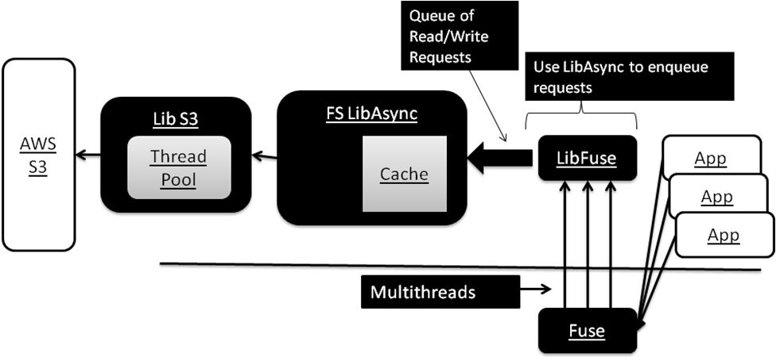
Design

Slide 4
Implementation
Libasync
  For handling write/read requests
  Using sockets to implement
  Libasync running on a different thread
Simple cash
  2 Maps, meta and data buckets
  LRU replacement policy, (partial)

Slide 5
Cache Detail
Cache
LRU Module
S3
META
DATA
LibAsync
Requests
Cache Entry detail
Char* key
Void* value
Bool dirty

Slide 6
Flow of Requests
Requests
Is it a Read?
No
Send Update Request and RETURN
Yes
Is object in the Cache?
Return object
No
Send Request of Read and WAIT response
Yes
Retrieve object from Cache

Slide 7
Key points
Libasync
  Used to queue the requests
  Perform the s3 ops
Flush to S3
  Is done after sending an answer to the user
  Could be done following some policy with the proper recovery and lock implementation
Cash (partial implementation)
  Simple cash, key=s3Key, value=data + flags
Recovery
  Not implemented

Slide 8
Improvements to be made
No failure support
  Ones it is written in the cash, it is assume it will be uploaded correctly.
Improve thread-safety
Improve data structures, flags and controls

